Slide 1

CEN Technical Committee 278: Intelligent Transport Systems
Mark Cartwright
1 April 2020

Slide 2
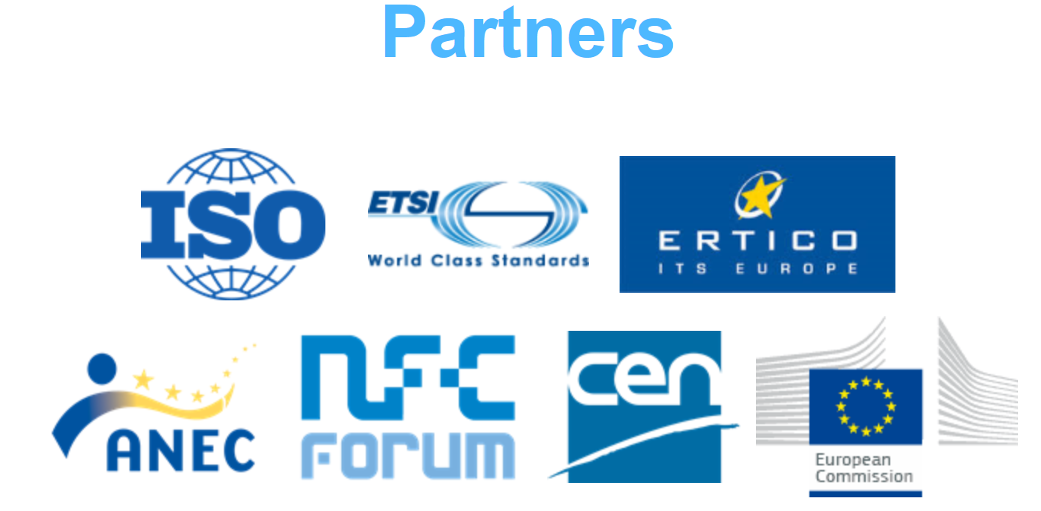
TC278 function
Responsible for managing the preparation of standards in the field of Intelligent Transport Systems (ITS) in Europe
A platform for European stakeholder to exchange knowledge, information, best practices and experiences in ITS

Slide 3
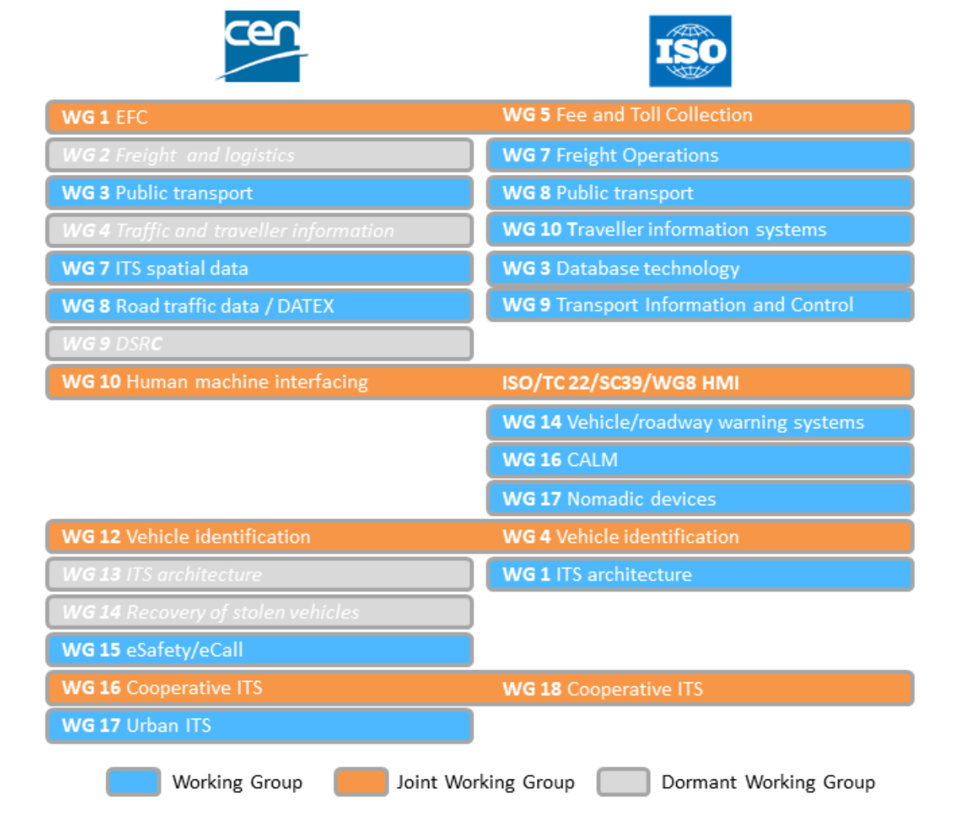
TC278 structures

Slide 4
TC 278 and European legislation
Directive 2004/52/EC (EFC directive) on the interoperability of electronic road toll systems in the Community
Directive 2010/40/EU (ITS directive) on the framework for the deployment of Intelligent Transport Systems in the field of road transport and for interfaces with other modes of transport
Commission Decision 2009/750/EC on the definition of the European Electronic Toll Service and its technical elements
Mandate M/338 on Electronic Fee Collection in support of Interoperability of electronic road toll systems in Europe
Mandate M/453 on Co-operative systems for Intelligent Transport in the field of information and communication technologies to support interoperability of cooperative systems for intelligent transport in Europe
Mandate M/546 on Urban ITS on Intelligent Transport Systems (ITS) in urban areas in support of Directive 2010/40/EU on the framework for the deployment of Intelligent Transport Systems in the field of road transport and for interfaces with other modes of transport.
The EC Rolling plan for ICT standardization provides an overview of the needs for preliminary or complementary ICT standardisation activities to be undertaken in support of EU policy activities.

Slide 5
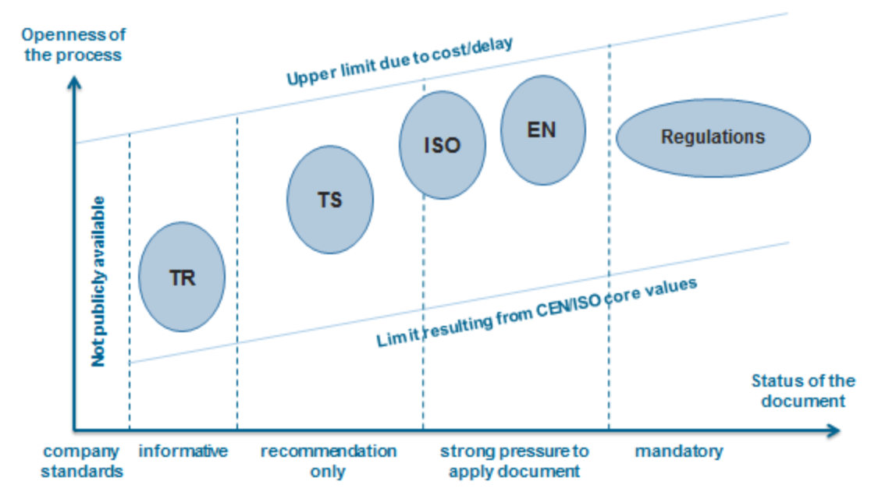
CEN products

Slide 6
CEN and MaaS
There is no strong, coordinated framework for MaaS within CEN products currently
But there are many rich, complex suites of standards that will be important and necessary components of any standardised MaaS environment
The home for cross-cutting initiatives within TC278 is WG17
This WG can make links with other necessary WGs: WG1 (tolling), WG3 (public transport), WG4 (travel info), WG8 (traffic), WG16 (connected mobility)

Slide 7
Workshop, 6 November 2019
Joint event involving CEN TC278, INEA and DG MOVE
Aim: to help lubricate the transfer of knowledge from EU-funded projects into standardisation
Projects involved: MOBIL.T, EuTravel, MASAI, ETC, IMOVE, MaaS4EU, MyCorridor, Shift2MaaS, MaaSive
Only introductory!

Slide 8
CEN working
Working Groups develop, submit and maintain standards
Tend to operate in one of three ways:
Self-generated products, developed by volunteer contributors – can be slow, highly dependent on who chooses to participate
Absorption of external products, with or without ongoing external support – more robust but dependent on third parties
Funded Project Teams – robust and independent, but lacks arrangement for maintenance

Slide 9
Criticisms of CEN (and other standards bodies)
It’s slow
It’s bureaucratic
It’s out of touch with the real world
It’s driven by special interests
There is an element of truth in all of these...

Slide 10
Some case studies – food for thought
UTMC
RTIG
C-Roads

Slide 11
Questions for TOMP-API WG
What do you want to promote as a European standard?
How do you see your future operations within NL interacting with the standards world?
How ready are you to align with the outputs of other MaaS initiatives?
What should you continue to develop and deploy within just NL?
What model of standard development do you think is appropriate for MaaS standards products?

